Slide 1
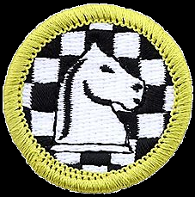
Chess Merit Badge
Troop 344 & 9344
Pemberville, OH

Slide 2
Chess Merit Badge Requirements
Discuss with your merit badge counselor the history of the game of chess. Explain why it is considered a game of planning and strategy.
Discuss with your merit badge counselor the following:
  The benefits of playing chess, including developing critical thinking skills, concentration skills, and decision-making skills, and how these skills can help you in other areas of your life
  Sportsmanship and chess etiquette

Slide 3
Chess Merit Badge Requirements
Demonstrate to your counselor that you know each of the following. Then, using Scouting’s Teaching EDGE, teach someone (preferably another Scout) who does not know how to play chess:
  The name of each chess piece
  How to set up a chessboard
  How each chess piece moves, including castling and en passant captures
Do the following:
  Demonstrate scorekeeping using the algebraic system of chess notation.
  Discuss the differences between the opening, the middle game, and the endgame.
  Explain four opening principles.
  Explain the four rules for castling.
  On a chessboard, demonstrate a "scholar's mate" and a "fool's mate."
  Demonstrate on a chessboard four ways a chess game can end in a draw.

Slide 4
Chess Merit Badge Requirements
Do the following:
  Explain four of the following elements of chess strategy: exploiting weaknesses, force, king safety, pawn structure, space, tempo, time.
  Explain any five of these chess tactics: clearance sacrifice, decoy, discovered attack, double attack, fork, interposing, overloading, overprotecting, pin, remove the defender, skewer, zwischenzug.
  Set up a chessboard with the white king on e1, the white rooks on a1 and h1, and the black king on e5. With White to move first, demonstrate how to force checkmate on the black king.
  Set up and solve five direct-mate problems provided by your merit badge counselor.
Do ONE of the following:
  Play at least three games of chess with other Scouts and/or your merit badge counselor. Replay the games from your score sheets and discuss with your counselor how you might have played each game differently.
  Play in a scholastic (youth) chess tournament and use your score sheets from that tournament to replay your games with your merit badge counselor. Discuss with your counselor how you might have played each game differently.
  Organize and run a chess tournament with at least four players, plus you. Have each competitor play at least two games.

Slide 5
Requirement 1
Discuss with your merit badge counselor the history of the game of chess. Explain why it is considered a game of planning and strategy.

Slide 6
History of the Game of Chess
The history of chess spans some 1500 years.
The earliest predecessors of the game originated in India, before the 6th century AD.
From India, the game spread to Persia. When the Arabs conquered Persia, chess was taken up by the Muslim world and subsequently spread to Southern Europe.
In Europe, chess evolved into its current form in the 15th century.

Slide 7
History of the Game of Chess
The game, as played during the early Middle Ages, was slow, with many games lasting for days.
Some variations in rules began to change the shape of the game by 1300 AD.
  A notable, but initially unpopular, change was the ability of the pawn to move two places in the first move instead of one.
The queen and bishop remained relatively weak until between 1475 AD and 1500 AD, in either Spain, Portugal, France or Italy, the queen's and bishop's modern moves started and spread, making chess close to its modern form.

Slide 8
History of the Game of Chess
In Europe some of the pieces gradually got new names and/or moves:
  Fers: "queen", because it starts beside the King.
  Aufin: "bishop", because its two points looked like a bishop's mitre.
  Pawn moving two squares in its first move. This led to the en passant rule: a pawn placed so that it could have captured the enemy pawn if it had moved one square forward was allowed to capture it on the passed square.
  King jumping once, to make it quicker to put the king safe in a corner. (This eventually led to castling.)

Slide 9
History of the Game of Chess
In the second half of the 19th century, modern chess tournament play began, and the first world Chess Championship was held in 1886.
The 20th century saw great leaps forward in chess theory and the establishment of the World Chess Federation (FIDE).
Developments in the 21st century include use of computers for analysis, which originated in the 1970s with the first programmed chess games on the market.
Online gaming appeared in the mid 1990's.

Slide 10
Chess: A Game of Planning and Strategy
It is considered a game of strategy and planning because during the game, you plan and do certain strategies based on the positional elements of the pieces.
  These include pawn structure, king safety, piece placement and mobility.
However, the answer is not quite as simple as saying that chess involves strategy and planning.
  The thing to notice is that chess does not involve chance.

Slide 11
Chess: A Game of Planning and Strategy
All of your theoretically possible next moves and your opponent's possible next moves that are known, defined, and visible to both players effects your strategy and planning.
The further ahead your brain can plan, the stronger you can become as a player.
A player with better planning and strategy will always win.

Slide 12
Chess: A Game of Planning and Strategy
Contrast this with a card game, and you will see that some elements of the card game depend on chance -- what cards you will draw in gin rummy for example; or a board game like Monopoly where the outcome depends in part on a roll of the dice.
In a gin rummy or a monopoly game sometimes luck will enable a player to win a game, even if his planning and strategy are not as good as his opponents.

Slide 13
Requirement 2
Discuss with your merit badge counselor the following:
  The benefits of playing chess, including developing critical thinking skills, concentration skills, and decision-making skills, and how these skills can help you in other areas of your life
  Sportsmanship and chess etiquette

Slide 14
The Benefits of Playing Chess
Here is a short list of just some of the benefits of learning and Playing Chess:
  Provides practice at making accurate and fast decisions under time pressure.
  Drills skills that can help improve exam scores.
  Improves reading.
  Pattern recognition enhanced.
  Teaches sportsmanship.
  Dealing with difficult choices.
  Making the best choice from a group of good choices.
  Teaches to learn from mistakes.

Slide 15
The Benefits of Playing Chess
Here is a short list of just some of the benefits of learning and Playing Chess:
  Responsibility for actions.
  Concentration is vigorously practiced.
  Logical reasoning is sharpened.
  Measurable individual accomplishments are enjoyed.
  Critical thinking.
  Memory is enhance.
  Problem solving and 'what if' skills.
  Intellectual maturity is fostered.

Slide 16
The Benefits of Playing Chess
Here is a short list of just some of the benefits of learning and Playing Chess:
  Belonging to a good crowd.
  Self esteem.
  Mind enrichment.
  Mental exercising.
  Analyzing actions and consequences.
  The importance of planning.

Slide 17
Sportsmanship and Chess Etiquette
Be polite, and get off to a good start.
Don’t boast, talk trash, or try to intimidate your opponent.
Don’t argue with your opponent.
Don’t give or ask for advice.
Don’t be annoying.
Don’t try to trick your opponent by pretending to have made a bad move.
Do not rush your opponent.
After your game, be a good winner or loser.
Saying “check” is not required, but is considered polite.

Slide 18
Requirement 3
Demonstrate to your counselor that you know each of the following. Then, using Scouting’s Teaching EDGE, teach someone (preferably another Scout) who does not know how to play chess:
  The name of each chess piece
  How to set up a chessboard
  How each chess piece moves, including castling and en passant captures

Slide 19
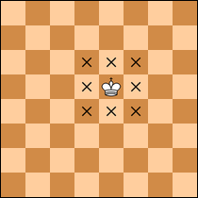
The King
The highest ranking Chess piece, and it can move one square at a time in any direction.
When the king is placed in jeopardy of being captured, it is said to be in check and must be moved, or the checking piece blocked by another piece.
If the king is placed in check, and the king cannot move to a safe square, and the danger cannot be blocked, or the checking piece captured, the king is said to be in checkmate and the game is over.

Slide 20
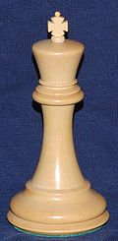
The King
The King is the highest ranking Chess piece, and it can move one square at a time in any direction.
When the King is placed in jeopardy of being captured, it is said to be in check and must be moved, or the checking piece blocked by another piece.
If the King is placed in check, and the king cannot move to a safe square, and the danger cannot be blocked, or the checking piece captured, the king is said to be in checkmate and the game is over.

Slide 21
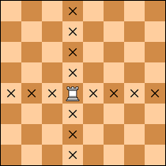
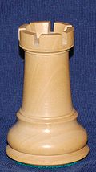
The Rook
The Rook, or Castle, can move one or multiple squares in a straight line in any direction.
There are two rooks per side, for a total of four.
It occupies the outside square of the very back row, one on each side, one occupying a black square and one occupying a red square of the chess board.

Slide 22
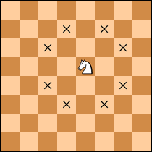
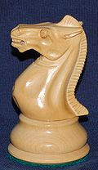
The Knight
There are two Knights per side, four knights per chess set.
The knight has the most complicated move.
It can move one square straight and one square diagonal any direction.
It is the only piece which can move around another piece.
The knight occupies the square right next to the rook in the back row, again one on red and one on white.

Slide 23
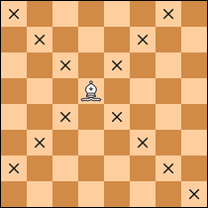
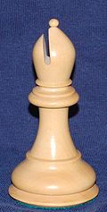
The Bishop
Bishops also number two per side, and can move one or multiple squares in any diagonal direction.
These are located right next to the knight in the back row.
These are the only pieces which occupy only one color square during the entire game.

Slide 24
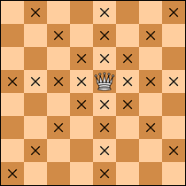
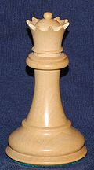
The Queen
The Chess Queen is the most powerful piece on the board, and each player has one.
It can move one or multiple squares, straight or diagonal.
The queen is located to the right of the King at the beginning of the game.

Slide 25
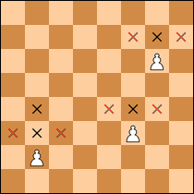
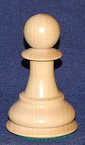
The Pawn
The Pawn is the weakest piece, as it can only move forward one square at a time but, on its initial move, it may move two squares.
It cannot move backwards.
There are eight pawns on each side and at the start of play the entire second row of the board is occupied by pawns.
If you advance a pawn to your opponent’s last row of squares, it can be promoted to a piece of any rank above it, including the queen, (even if you already have one on the board.)

Slide 26
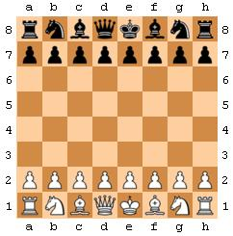
How to Set Up a Chessboard

Slide 27
Castling
Castling can only occur if there are no pieces standing between the king and the rook.
Neither king nor the rook to be castled with may have moved from its original position.
There can be no opposing piece that could possibly capture the king in his original square, the square he moves through or the square that he ends the turn.

Slide 28
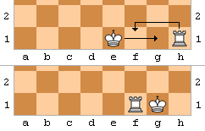
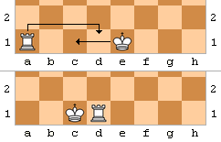
Castling
The king moves two squares toward the rook he intends to castle with (this may be either rook).
The rook then moves to the square through which the king passed.

Slide 29
En Passant Captures
En passant captures is a special pawn capture which can occur immediately after a player moves a pawn two squares forward from its starting position, and an enemy pawn could have captured it had it moved only one square forward.
The opponent captures the just-moved pawn as if taking it "as it passes" through the first square.
The resulting position is the same as if the pawn had moved only one square forward and the enemy pawn had captured normally.

Slide 30
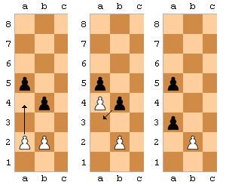
En Passant Captures
The en passant capture must be done on the very next turn, or the right to do so is lost.
Such a move is the only occasion in chess in which a piece captures but does not move to the square of the captured piece.

Slide 31
Requirement 4
Do the following:
  Demonstrate scorekeeping using the algebraic system of chess notation.
  Discuss the differences between the opening, the middle game, and the endgame.
  Explain four opening principles.
  Explain the four rules for castling.
  On a chessboard, demonstrate a "scholar's mate" and a "fool's mate."
  Demonstrate on a chessboard four ways a chess game can end in a draw.

Slide 32
The Algebraic System of Chess Notation
Algebraic notation (or AN) is a method for recording and describing the moves in a game of chess.
It is now standard among all chess organizations and most books, magazines, and newspapers.

Slide 33
The Algebraic System of Chess Notation
Each square of the chessboard is identified by a unique coordinate pair consisting of a letter and a number.
The vertical rows of squares (called files) from White's left (the queenside) to his right (the kingside) are labeled a through h.
The horizontal rows of squares (called ranks) are numbered 1 to 8 starting from White's side of the board.

Slide 34
The Algebraic System of Chess Notation
Thus, each square has a unique identification of file letter followed by rank number.
For example, the white king starts the game on square e1, while the black knight on b8 can move to open squares a6 or c6.

Slide 35
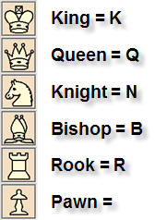
The Algebraic System of Chess Notation
Each type of piece (other than pawns) is identified by an uppercase letter, usually the first letter in the name of the piece in whatever language is spoken by the player recording.
Pawns are not indicated by a letter, but rather by the absence of any letter—it is not necessary to distinguish between pawns for moves, since only one pawn can move to a given square.

Slide 36
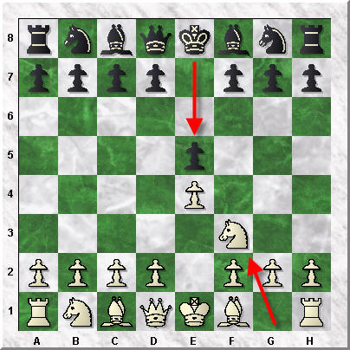
The Algebraic System of Chess Notation
Each move of a piece is indicated by the piece's uppercase letter, plus the coordinate of the destination square. For example, e5 (black moves a pawn to e5—no piece letter in the case of pawn moves) Nf3 (move a knight to f3), .

Slide 37
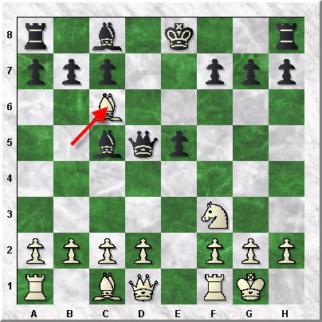
The Algebraic System of Chess Notation
When a piece makes a capture, an x is inserted between the piece's letter and the destination square.
For example, Bxc6 (bishop captures the piece on c6).

Slide 38
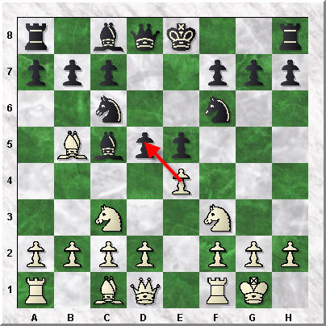
The Algebraic System of Chess Notation
When a pawn makes a capture, the file from which the pawn departed is used to identify the pawn, rather than a letter representing the pawn itself.
For example, exd5 (pawn on the e-file captures the piece on d5).

Slide 39
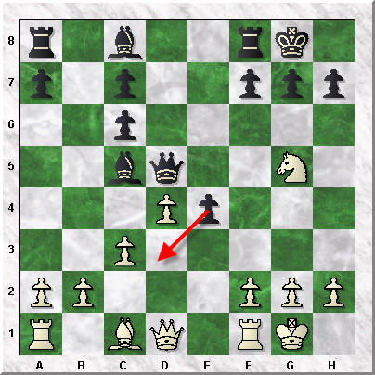
The Algebraic System of Chess Notation
En passant captures are notated by specifying the capturing pawn's file of departure, the x, the destination square (not the square of the captured pawn), and the suffix e.p. indicating the capture was en passant.
For example, exd3e.p.

Slide 40
The Algebraic System of Chess Notation
When two (or more) identical pieces can move to the same square, the moving piece is uniquely identified by specifying the piece's letter, followed by (in descending order of preference):
  The file of departure (if they differ); or
  The rank of departure (if the files are the same but the ranks differ); or
  Both the rank and file (if neither alone is sufficient to identify the piece—which occurs only in rare cases where one or more pawns have promoted, resulting in a player having three or more identical pieces able to reach the same square).

Slide 41
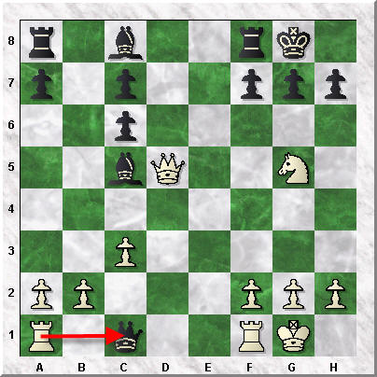
The Algebraic System of Chess Notation
For example, with rooks on a1 and f2, either of which might move to c3, the "a" must be included to indicate which rook.
Notice how the move is Raxc1.
As noted above, an x is inserted to indicate a capture.

Slide 42
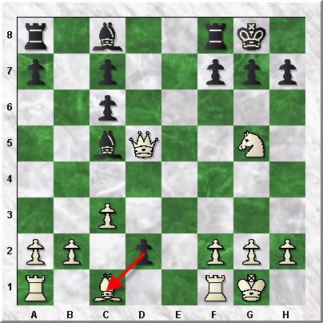
The Algebraic System of Chess Notation
When a pawn moves to the last rank and promotes, the piece promoted to is indicated at the end of the move notation.
Black captures White's Bishop on c1 with dxc1=Q.

Slide 43
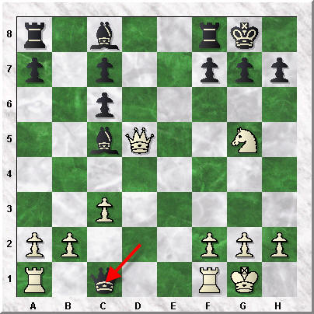
The Algebraic System of Chess Notation
dxc1=Q means pawn captures piece on c1 and promotes it to a Queen.
Black could promote it to any other piece he chooses, but Queen's are nearly always the best choice.

Slide 44
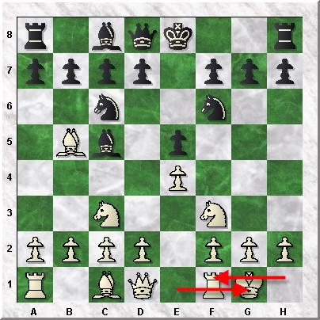
The Algebraic System of Chess Notation
See how white has made a special move called castling kingside. This move is written as 0-0. If the King castles on the queenside (to the other direction on the chessboard) it would be written as 0-0-0.

Slide 45
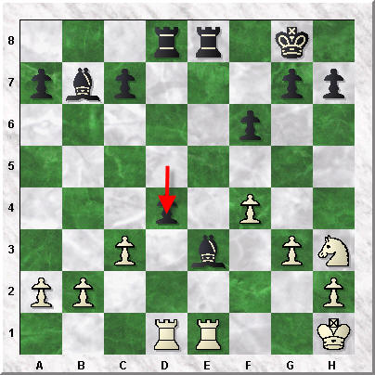
The Algebraic System of Chess Notation
A move which places the opponent's king in check usually has the notation "+" appended.
Checkmate at the completion of moves is notated "++”.
d4++ “Checkmate”
The notation 1–0 at the completion of moves indicates that White won, 0–1 indicates that Black won, and ½–½ indicates a draw.

Slide 46
The Algebraic System of Chess Notation
Notice how the previous moves and notations have been shown on the sample score sheet.

Slide 47
Stages in the Game of Chess
There are three distinct stages to the game of chess that you need to know in order to be a winning chess player.
These three stages are the:
  Opening
  Middle
  Endgame.
Each stage has different goals and objectives.

Slide 48
Opening Stage
The opening you want to get a rapid development of your primary pieces.
You also want to safe guard your king, generally by castling.
It is in this phase of the game that you want to try and achieve dominance over the middle four squares of the board.
Generally the opening lasts between ten to twenty moves roughly.

Slide 49
Middle Stage
The middle game is when you begin to coordinate your primary pieces and attack your opponent‘s weak spots and open files.
The goal is to win primary pieces from your opponent or even be able to checkmate your opponent.
The middle game is approximately from the end of the opening phase until around move forty.

Slide 50
End Stage
The end game is when you use your remaining primary pieces to take advantage of the weaknesses that you created in your opponent‘s defense during the middle game.
The endgame often concludes when one of the players is able to move a pawn to the other side of the board and thus turn that pawn in for a queen.
This is then followed by a checkmate or a resignation.
Strategy, not tactics are what need to be considered in the end game.

Slide 51
Classical Opening Principles
The four major aspects of Classical Opening Principles are:
  Centralization
  Quick Development
  Early castling
  Knights before Bishops

Slide 52
Centralization
The most important part in the chessboard is the center.
Pieces placed in the center attack more squares than those positioned on the sides of the board.
  A knight placed in “d4” can effectively attack eight squares.
  They are c2, b3, b5, c6, e6, f5, f3, and e2.
  The same knight in h1 can attack only two squares – f2 and g3.
If you do not control or possess a fair share of the center, then it might be difficult to maneuver pieces from one side of the board to the other side of the board.

Slide 53
  Quick Development
The second important part of Classical Opening Principles is Quick Development.
You might know that pawns are of the lowest cadre.
The minor pieces such as bishops and knights are the next cadre.
The Queen and the rooks are the major pieces in the chessboard.
The ultimate superior is the King.

Slide 54
Quick Development
According to classical principles, developing minor pieces is considered important before developing major pieces such as rooks and the queen.
It should be ensured that pawn movements are restricted to the minimum.
The knights can jump over other pieces in the board and as such, pawn movement is not necessary for developing the knights.
If you open up the pawns in front of the King and the Queen, then the two bishops are opened up, and so are the Queen and the King.

Slide 55
  Early Castling
Castling is one of the special moves in chess where the king is allowed to move two squares in a single move.
In addition, two pieces are moved in a single move, the King and the Rook.

Slide 56
  Early Castling
The two rooks are in the two corners.
In line with the concept of quick development, both the minor pieces such as bishops and knights can be moved out after the pawns in front of the queen and the king are opened.
Now there will be no pieces in between the King and the Rook at the kingside, while queen will be there in the queenside.
You can take up castling on the kingside, thereby opening up the rook to combine with the Queen and the other rook.
In addition, the King in the first row will be guarded by the Queen and two rooks.

Slide 57
  Knights before Bishops
Another part of the classical opening principles is to move the knights before the bishop.
As already stated, the knights can be moved without waiting for the pawns to leave way, as they are capable of jumping over pieces lying in between the original square and the destination square of the knight.
As such, it is suggested that knights are moved into the front before opening up the bishops.

Slide 58
The Four Rules of Castling
Castling is only permissible if all of the following conditions hold:
  The king and rook involved in castling must not have previously moved;
  There must be no pieces between the king and the rook;
  The king may not currently be in check, nor may the king pass through or end up in a square that is under attack by an enemy piece (though the rook is permitted to be under attack and to pass over an attacked square);
  The king and the rook must be on the same rank.

Slide 59
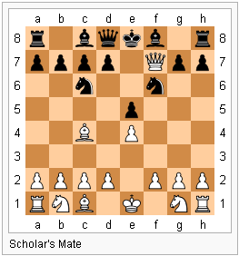
Scholar’s Mate
Scholar's Mate is the checkmate achieved by the moves 1. e4 e5 2. Qh5 Nc6 3. Bc4 Nf6 4. Qxf7++.
The moves might be played in a different order or in slight variation, but the basic idea is the same—the queen and bishop combine in a simple mating attack on f7 (or f2 if Black is performing the mate).

Slide 60
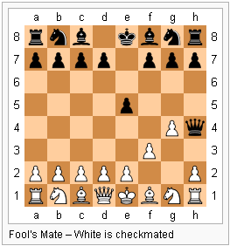
Fool’s Mate
Fool's Mate is the quickest possible checkmate in the game of chess.
A prime example consists of the moves:
  1. f3 e5
  2. g4 Qh4++
The pattern can have slight variations – White might play f2-f4 instead of f2-f3 or move the g-pawn before the f-pawn, and Black might play e7-e6 instead of e7-e5.

Slide 61
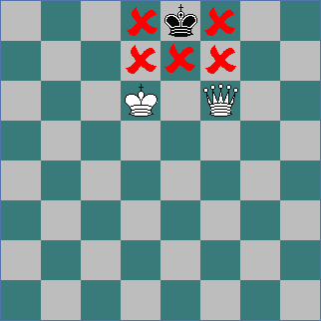
Draws in Chess
The game ends in a draw if any of these conditions occur:
  The game is automatically a draw if the player to move is not in check but has no legal move. This situation is called a stalemate. An example of such a position is shown in the diagram to the right.
  The game is immediately drawn when there is no possibility of checkmate for either side with any series of legal moves. This draw is often due to insufficient material, including the endgames:
    king against king;
    king against king and bishop;
    king against king and knight;
    king and bishop against king and bishop, with both bishops on diagonals of the same color.

Slide 62
Draws in Chess
The game ends in a draw if any of these conditions occur:
  Both players agree to a draw after one of the players makes such an offer.
  The player having the move may claim a draw by declaring that one of the following conditions exists, or by declaring an intention to make a move which will bring about one of these conditions:
    Fifty-move rule: There has been no capture or pawn move in the last fifty moves by each player.
    Threefold repetition: The same board position has occurred three times with the same player to move and all pieces having the same rights to move, including the right to castle or capture en passant.

Slide 63
Requirement 5
Do the following:
  Explain four of the following elements of chess strategy: exploiting weaknesses, force, king safety, pawn structure, space, tempo, time.
  Explain any five of these chess tactics: clearance sacrifice, decoy, discovered attack, double attack, fork, interposing, overloading, overprotecting, pin, remove the defender, skewer, zwischenzug.
  Set up a chessboard with the white king on e1, the white rooks on a1 and h1, and the black king on e5. With White to move first, demonstrate how to force checkmate on the black king.
  Set up and solve five direct-mate problems provided by your merit badge counselor.

Slide 64
Exploiting Weaknesses
Chess requires that we look for weaknesses in our opponent‘s positions while keeping ourselves out of weak positions.
As always, the game remains a balance of attacking and defending.
A weakness is simply a flaw in a position that we can exploit.
These weaknesses can be anything from an open line to poor piece placement to overworked pieces.
Depending on what stage we are at in the game we will see different weaknesses in our opponent.

Slide 65
Force
A recurring aim of chess strategy is to force your opponent to choose between a bad scenario and a downright unpleasant one.
  i.e. having to choose between saving a queen or rook or forcing your opponent to move out of check and sacrificing a piece as a result.)

Slide 66
King Safety
An unsafe king is generally the greatest weakness a position can have.
Typical elements that weaken the king’s safety are:
  Any weakness or absence in the pawn shield in front of the king.
  Fewer defenders than opposing attackers in the area near the king.
  Lack of center control gives attacking pieces easier access towards the unsafe king.
  A king that delayed castling for too long (unless the center is blocked).

Slide 67
Pawn Structure
The quality of the pawn structure can usually be judged by these factors:
  How it supports and affects the mobility of the pieces,
  How dynamic it is (how easily it can change),
  The presence of weaknesses like some isolated pawns and
  The squares which have been permanently weakened by pawn moves.
If possible, weaknesses in the pawn structure should be fixed before they become permanent.
However, a weakness in the pawn structure is only relevant if the opponent can attack them.

Slide 68
Space
Space advantage refers to one side controlling more squares of the board than the other side.
Since this extra space will naturally increase the mobility and flexibility of your pieces – their quality will increase.
It follows that the space advantage is one of the most important chess strategic advantages you should play for.

Slide 69
Tempo
Tempo refers to a "turn" or single move.
When a player achieves a desired result in one fewer move, he "gains a tempo" and conversely when he takes one more move than necessary he "loses a tempo".
Similarly, when one forces his opponent to make moves not according to the initial plan, one "gains tempo" because the opponent wastes moves.

Slide 70
Timing
Tournament games are played under time constraints, called time controls, using a game clock.
Each player must make his moves within the time control or forfeit the game.
There are different types of time controls.
  In some cases each player will have a certain amount of time to make a certain number of moves.
  In other cases each player will have a limited amount of time to make all of his moves.

Slide 71
Chess Tactics
Clearance sacrifice occurs when the attacker deliberately sacrifices material in order to “clear the way” for one of his pieces.
This can mean freeing a diagonal, a file, a rank, or a square so that a piece can make use of it for attacking purposes.

Slide 72
Chess Tactics
Decoy is a chess tactic where an important piece, usually the King or Queen of the opponent, is forced to move to some specific position where it can be subjected to a mating or capturing attack.
This tactic is also commonly associated with a sacrifice.

Slide 73
Chess Tactics
Discovered attack is a move which allows an attack by another piece.
A piece is moved away so as to allow the attack of a friendly bishop, rook or queen on an enemy piece.

Slide 74
Chess Tactics
Double attack is two attacks made with one move:
  These attacks may be made by the same piece (in which case it is a fork);
  or by different pieces (a situation which may arise via a discovered attack in which the moved piece also makes a threat).
The attacks may directly threaten opposing pieces, or may be threats of another kind:
  For instance, to capture the queen and deliver checkmate.

Slide 75
Chess Tactics
Fork is a tactic that uses a single piece to attack multiple pieces at the same time. The attacker usually hopes to gain material by capturing one of the opponent's pieces. The defender often finds himself in a difficult position in which he cannot counter all threats. The attacking piece is known as the forking piece. Conversely, the pieces that the forking piece is attacking are said to be forked.

Slide 76
Chess Tactics
Interference occurs when the line between an attacked piece and its defender is interrupted by sacrificially interposing a piece.

Slide 77
Chess Tactics
Overloading is a chess tactic in which a defensive piece is given an additional defensive assignment which it cannot complete without abandoning its original defensive assignment.

Slide 78
Chess Tactics
Overprotection in chess is the strategy of protecting a pawn or specific square of the chessboard more than is immediately necessary.
This serves to dissuade the opponent from attacking that specific point and provides greater freedom of movement for the pieces protecting that square.

Slide 79
Chess Tactics
Pinning is when a piece cannot move (either legally or advisedly) because doing so would expose a valuable piece, usually the king or queen, to attack.
Pins against the king are called absolute because it is then illegal to move the pinned piece.

Slide 80
Chess Tactics
Skewer An attack to a valuable piece, compelling it to move to avoid capture and thus exposing a less valuable piece which can then be taken.

Slide 81
Chess Tactics
Zwischenzug means intermediate move.
Picture your opponent making a move that directly threatens one of your pieces.
After you opponent has done this you are able to follow up with the Zwischenzug tactic.
When this tactic is used in the game of chess you will make a move that poses an even more devastating threat, instead of countering a direct threat, which the opponent expected you to do.
Often the move that you made will be a direct attack against the opponent’s queen or the king.
The opponent is forced to counter that threat against his or her queen or king first and this will ideally change the situation to his or her disadvantage.

Slide 82
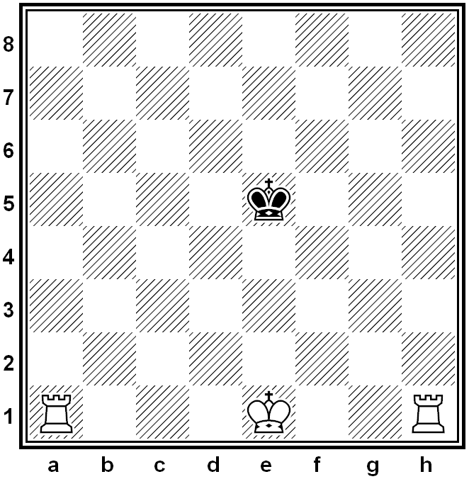
Demonstrate how to Force Checkmate
White king on e1, white rooks on a1 and h1, and the black king on e5.
With White to move first, demonstrate how to force checkmate on the black king.

Slide 83
Demonstrate how to Force Checkmate
Rh4 Kf5
Ra5+ Kg6
Rb4 Kf6
Rb6+ Ke7
Ra7 Kd8
Rb8++

Slide 84
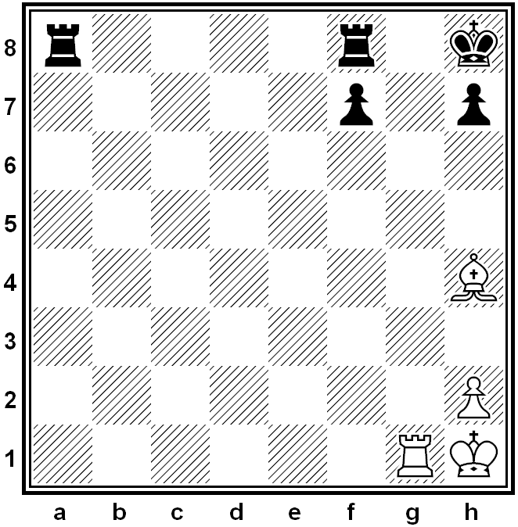
Mate in 1
Problem #1

Slide 85
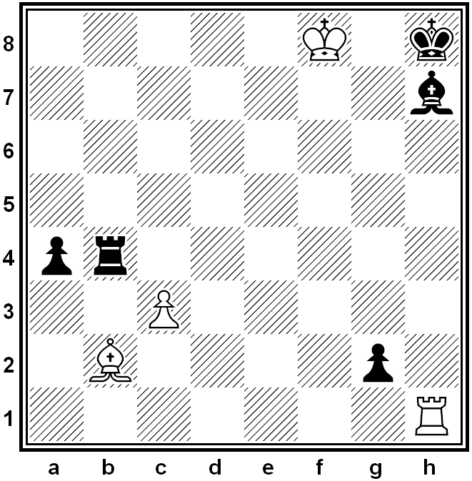
Mate in 1
Problem #2

Slide 86
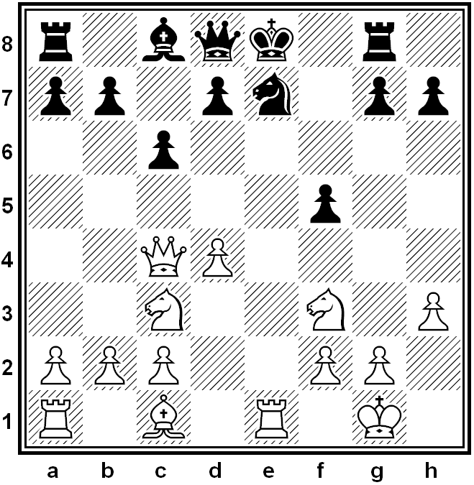
Mate in 1
Problem #3

Slide 87
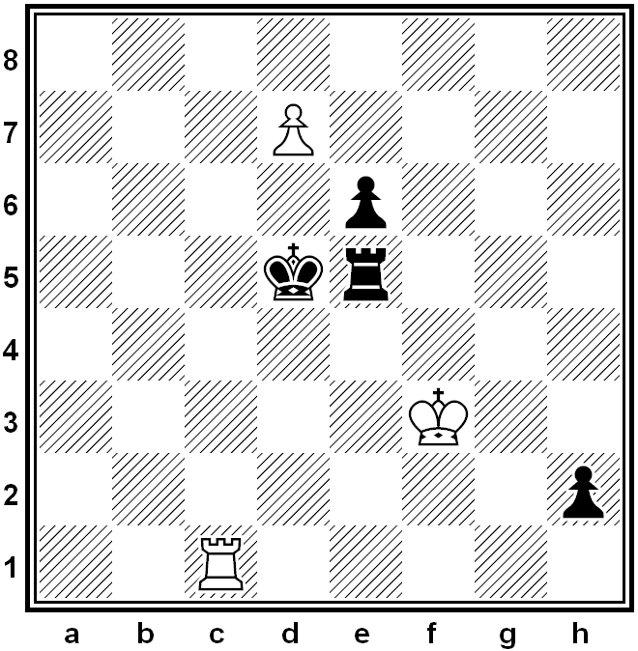
Mate in 1
Problem #4

Slide 88
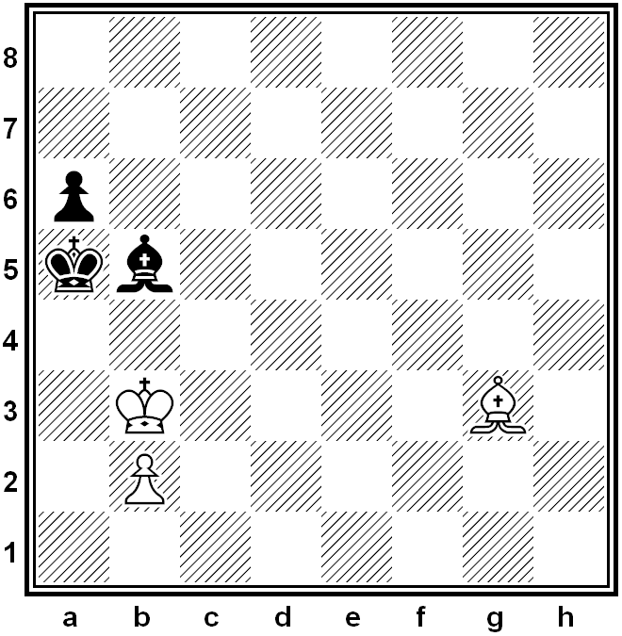
Mate in 1
Problem #5

Slide 89
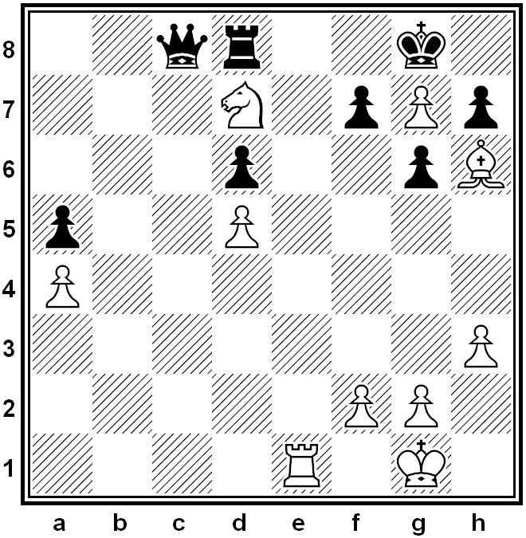
Mate in 1
Problem #6

Slide 90
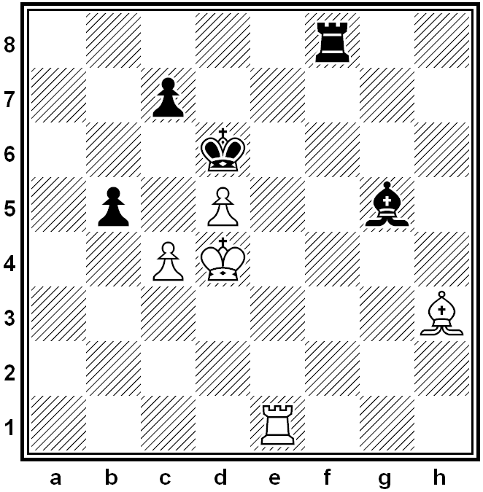
Mate in 1
Problem #7

Slide 91
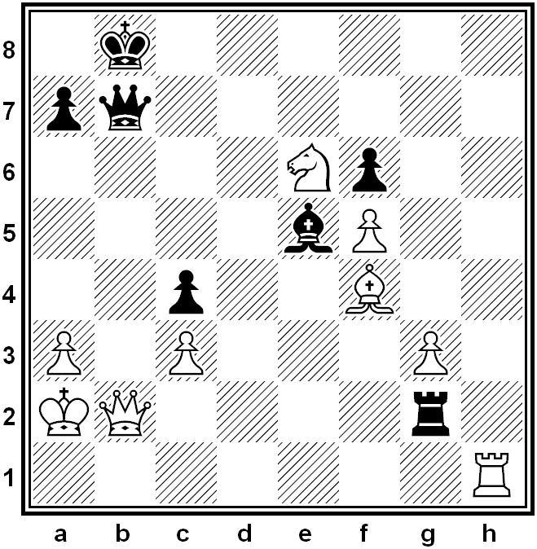
Mate in 1
Problem #8

Slide 92
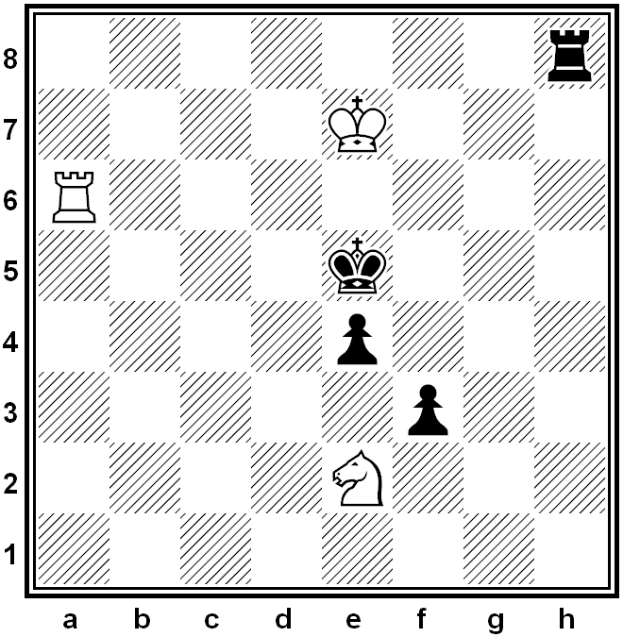
Mate in 1
Problem #9

Slide 93
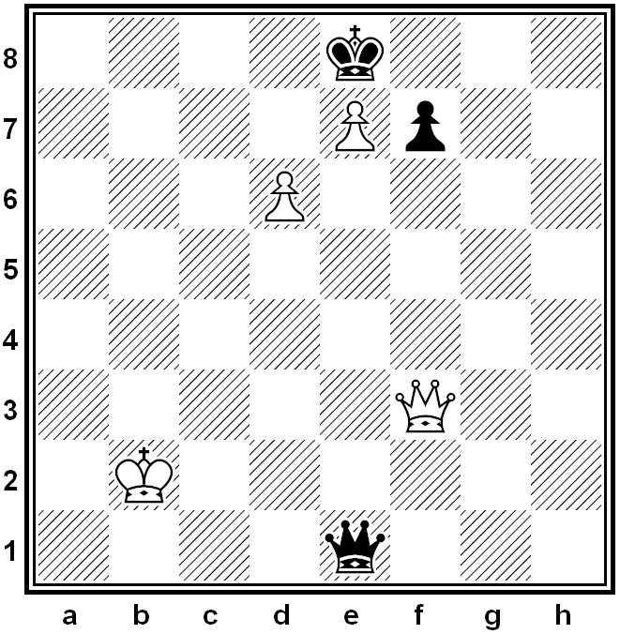
Mate in 1
Problem #10

Slide 94
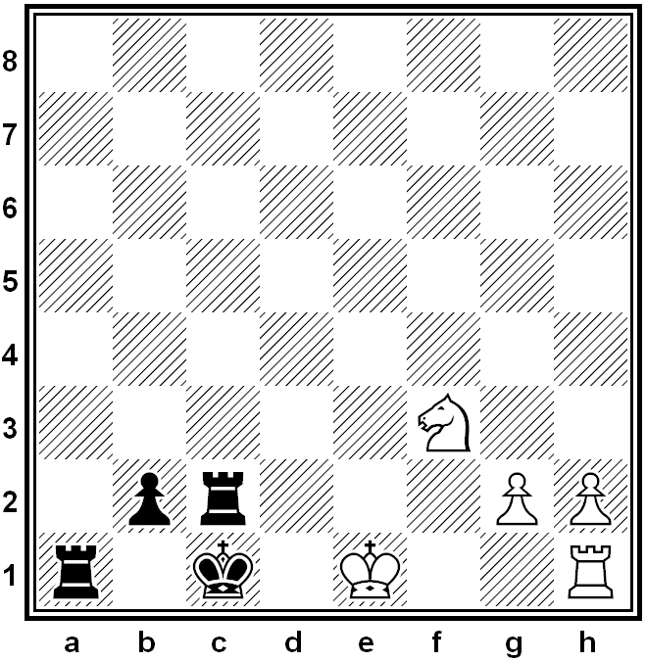
Mate in 1
Problem #11

Slide 95
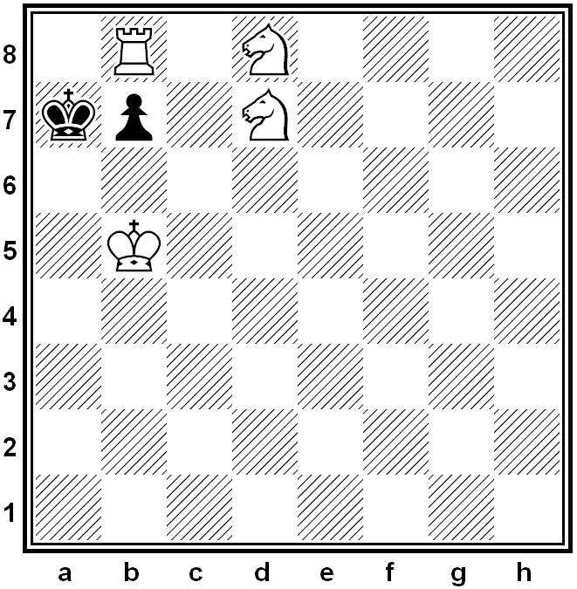
Mate in 2
Problem #12

Slide 96
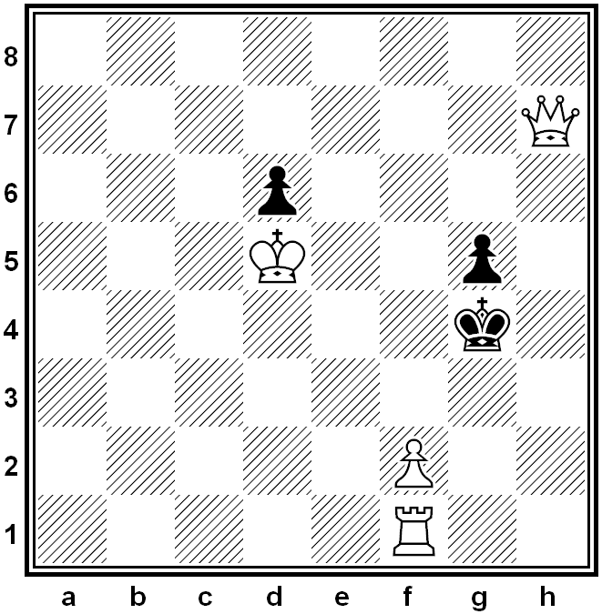
Mate in 2
Problem #13

Slide 97
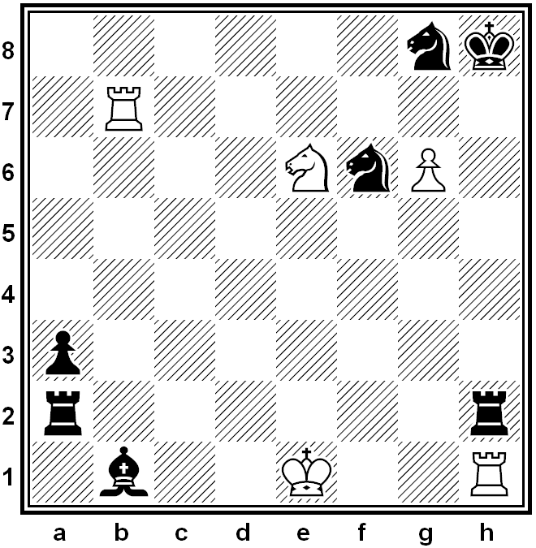
Mate in 2
Problem #14

Slide 98
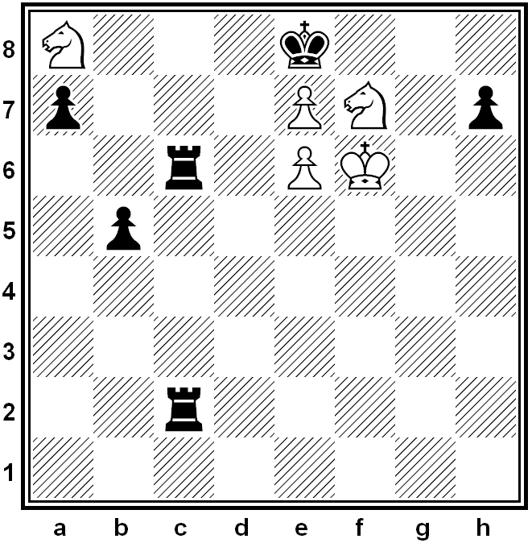
Mate in 2
Problem #15

Slide 99
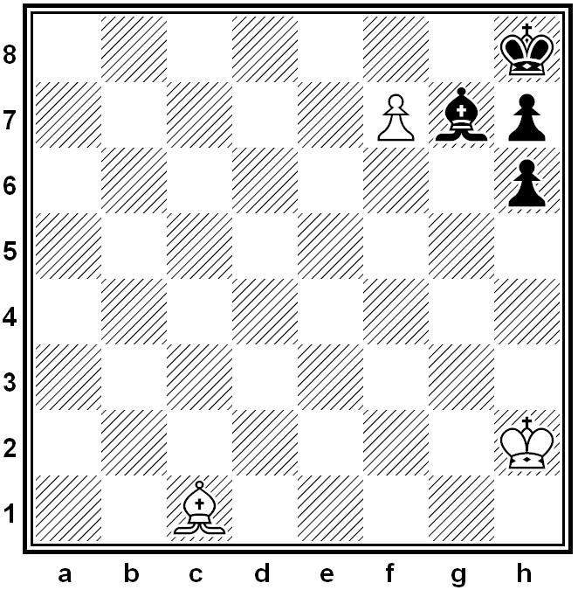
Mate in 2
Problem #16

Slide 100
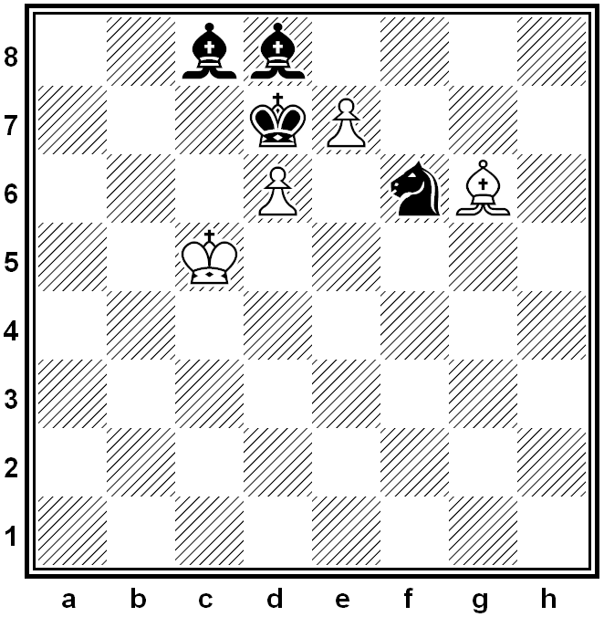
Mate in 2
Problem #17

Slide 101
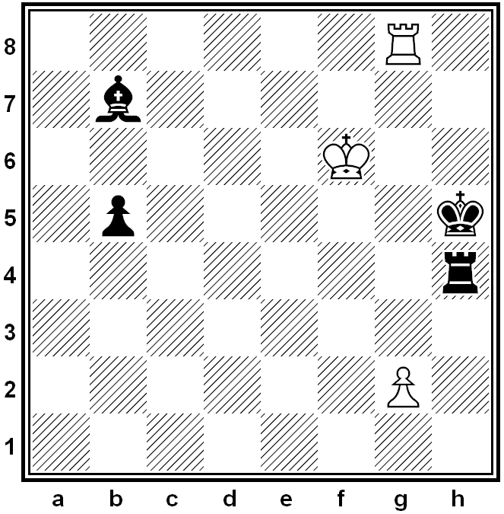
Mate in 2
Problem #18

Slide 102
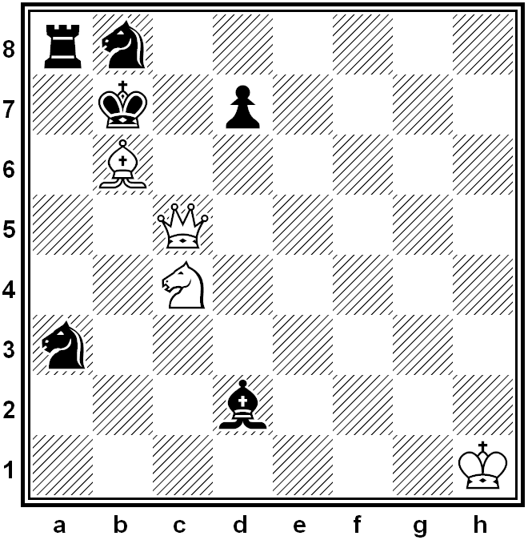
Mate in 2
Problem #19

Slide 103

Mate in 2
Problem #20

Slide 104

Mate in 2
Problem #21

Slide 105

Mate in 2
Problem #22

Slide 106

Mate in 2
Problem #23

Slide 107

Mate in 2
Problem #24

Slide 108

Mate in 2
Problem #25

Slide 109

Mate in 2
Problem #26

Slide 110
Solutions
Problem # | Solution
1 | 1. Bf6#
2 | 1. cxb4#
3 | 1. Qxg8#
4 | 1. d8Q# (or d8R#)
5 | 1. Bc7#
6 | 1. Nf6#

Slide 111
Solutions
Problem # | Solution
7 | 1. c5#
8 | 1. Rh8#
9 | 1. Ra5#
10 | 1. Qc6#
11 | 1. 0-0#
12 | 1. Rxb7+ Ka8 2. Nb6#
13 | 1. Qe4+ Kh5 (or Kh3) 2. Rh1#

Slide 112
Solutions
Problem # | Solution
14 | 1. Rh7+ Nxh7 2. g7# (or 1. Rh7+ Rxh7 2. g7#)
15 | 1. Nc7+ Rxc7 2. Nd6#
16 | 1. Bb2 Bxb2 2. f8Q#
17 | 1. e8Q Nxe8 2. Bf5#
18 | 1. g4 Rxg4 2. Rh8# (or 1. g4 Kh6 2. Rh8#)
19 | 1. Qc8+ Kxc8 2. Nd6# (or 1. Nd6+ Ka6 2. Qa5#)
20 | 1. Nd6+ Rxd6 2. Rb8#

Slide 113
Solutions
Problem # | Solution
21 | 1. Rc8 Qxc8 2. Nf7#
22 | 1. Rg7+ Qxg7 2. Ne3# (or 1. Rg7+ Kf5 2. Rg5#)
23 | 1. Rxb5 Rxb5 2. Nc4# (or 1. Rxb5 Nxb5 2. Nc4#)
24 | 1. Re8+ Kxe8 2. Rg8#
25 | 1. Rg3 fxg3 2. fxg3# (or 1. Rg3 R(any) 2. Rxh3#)
26 | 1. g7 Nxg7 2. Ng6#

Slide 114
Requirement 6
Do ONE of the following:
  Play at least three games of chess with other Scouts and/or your merit badge counselor. Replay the games from your score sheets and discuss with your counselor how you might have played each game differently.
  Play in a scholastic (youth) chess tournament and use your score sheets from that tournament to replay your games with your merit badge counselor. Discuss with your counselor how you might have played each game differently.
  Organize and run a chess tournament with at least four players, plus you. Have each competitor play at least two games.

